Slide 1



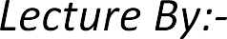


Slide 2

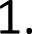

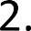

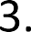
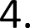


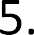

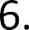

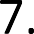


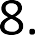
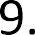


Slide 3
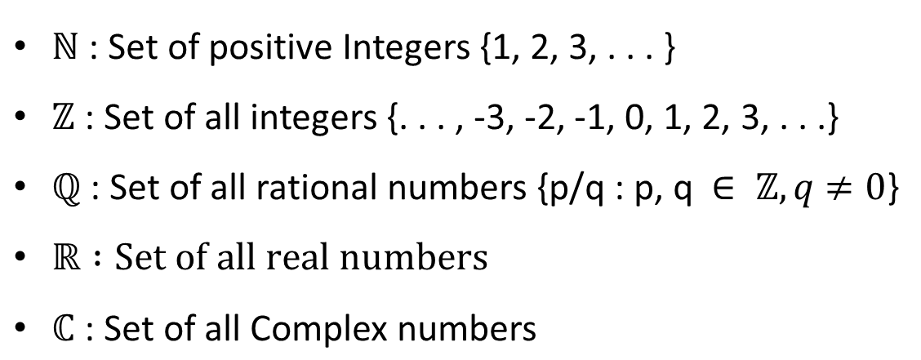

Slide 4

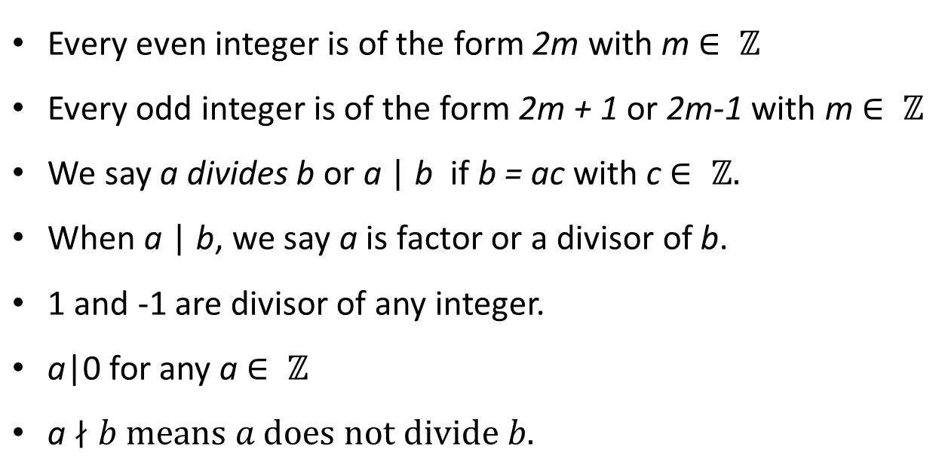

Slide 5

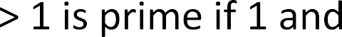

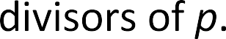

•
•
•
•
•

Slide 6
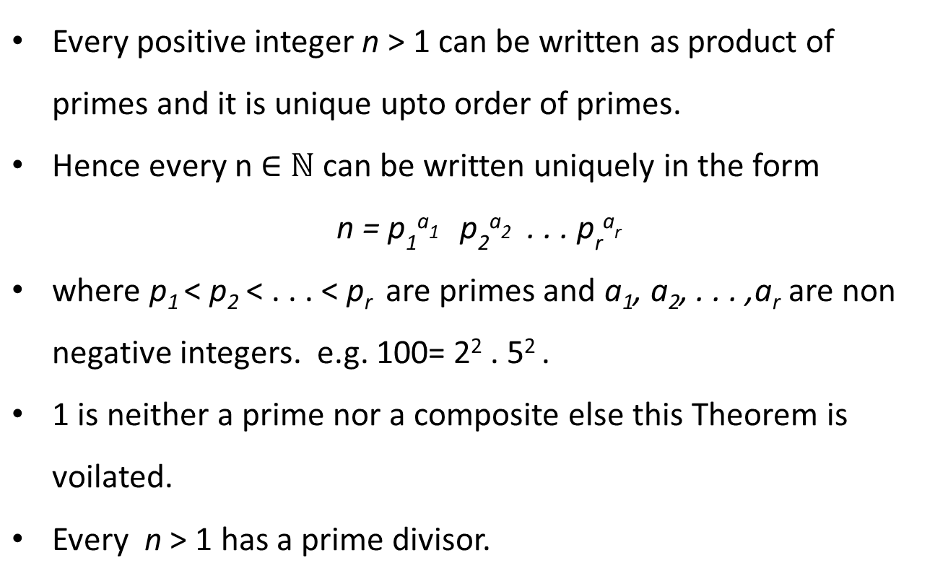

Slide 7
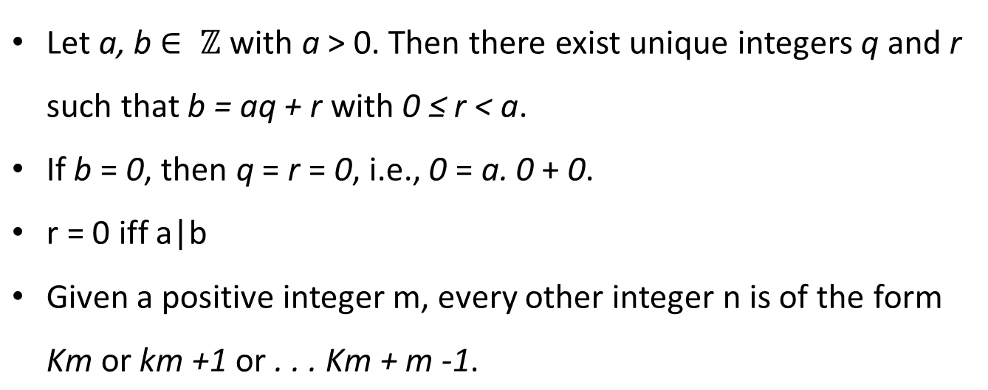
Division theorem and Division algorithms

Slide 8
Division theorem and Division algorithms

Slide 10

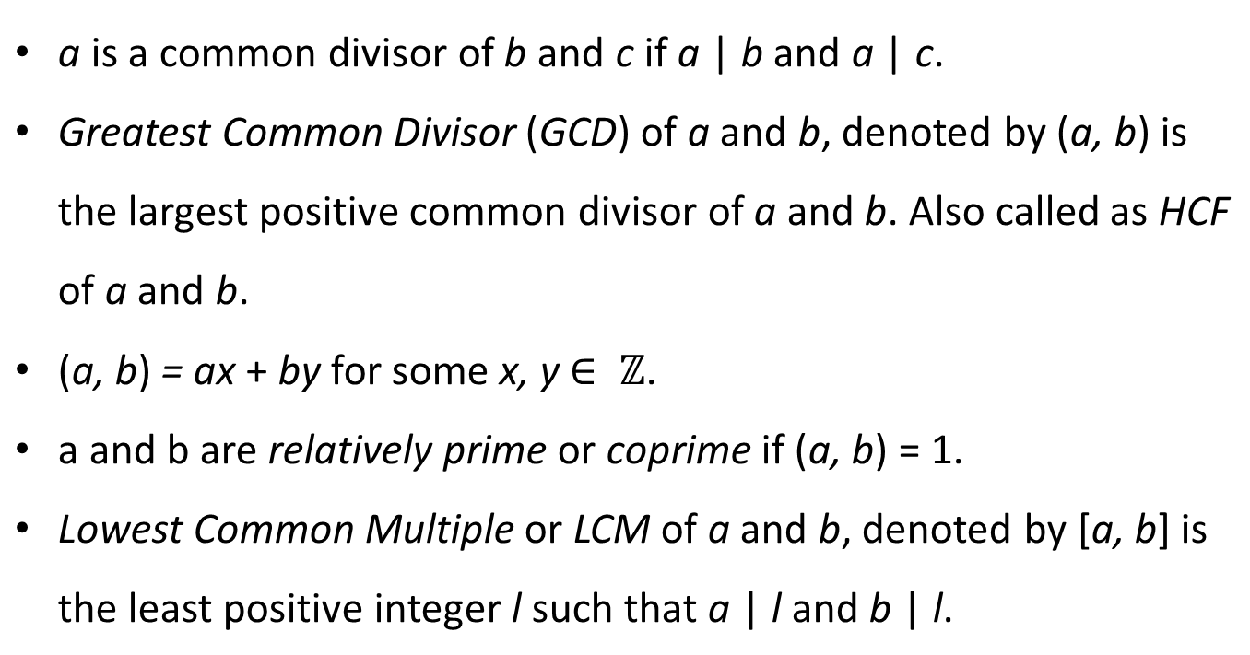

Slide 11
GCD

Slide 12
GCD Algorithm E
GCD(a,b)
Find a/b if remainder is zero then d=gcd(a,b)=b
Otherwise a=b and b=remainder
Repeat above steps till remainder is zero
Why and how it works ?

Slide 13
Euclidean Algorithm
If r₁ is 0 then b|a d=gcd(a,b)=b
If r₁ ≠ 0 then d|r₁ ?
Divisibility theorem
What is that theorem – seen already
Since d|a and d|b shows d|(a-q₁b) this is equal to d|r1
So find gcd(b,r1)

Slide 14
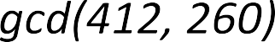

Slide 15
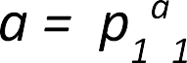
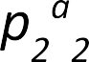
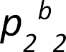
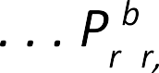
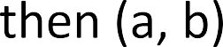
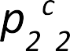
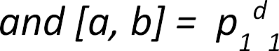
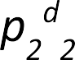
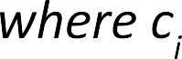
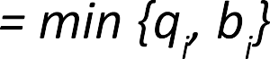
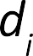
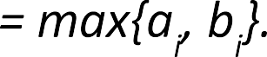

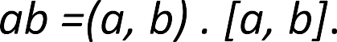
•
•

Slide 16
Extended Euclidean Algorithm

Slide 21
n|(a-b)
(a-b)=kn for some k
a=b+kn
Take modulo both side
(a mod n) = (b mod n) so a≡b(mod n)
n|(a-b) then n|(b-a) b≡a(mod n)
a=b+k1n b= c+k2n then a=c+(k1+k2)n
a=c+Kn
Then a≡c (mod n)

Slide 22
Modular Arithmetic

Slide 23
Example

Slide 29


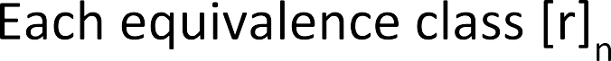

●
●
●
●

Slide 30










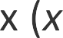










∈
≡

Slide 31

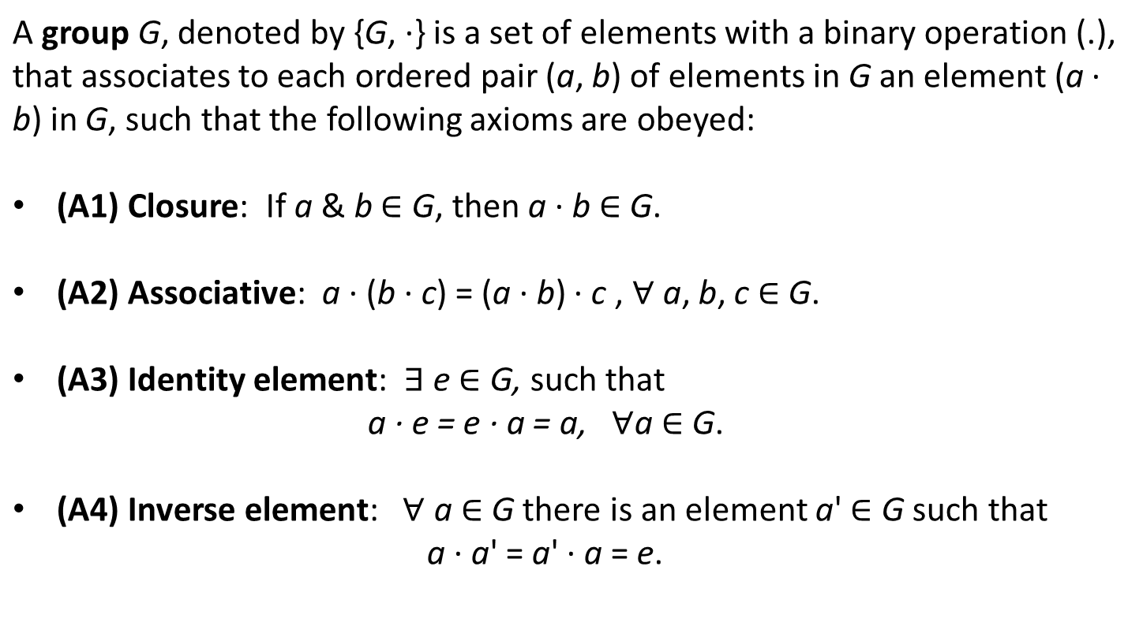

Slide 32

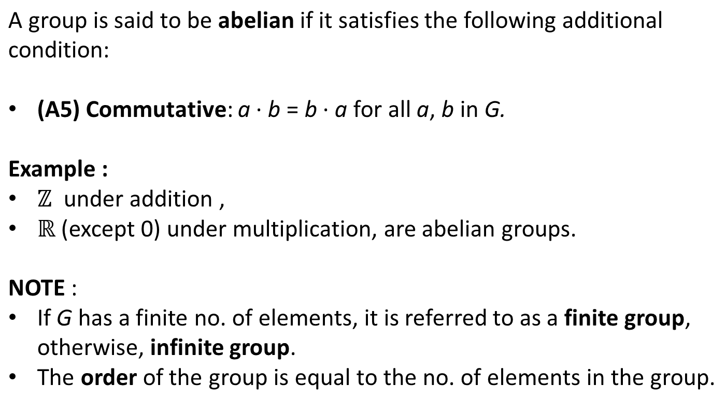

Slide 33

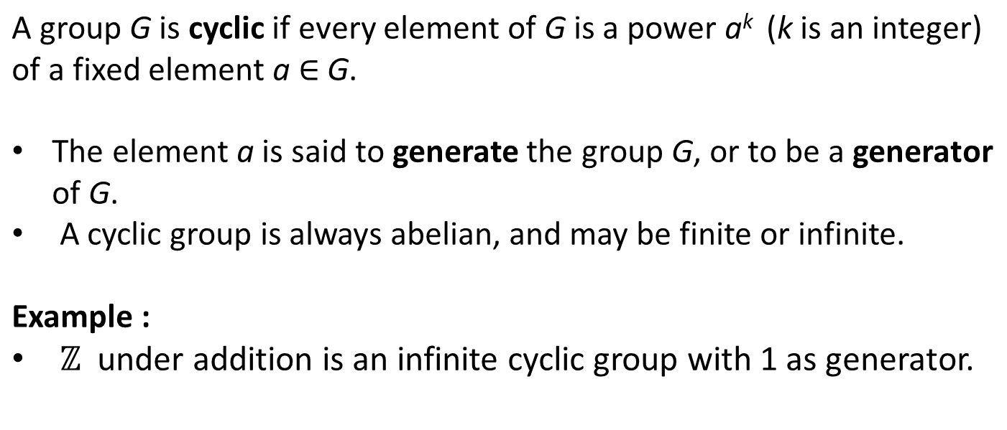

Slide 34

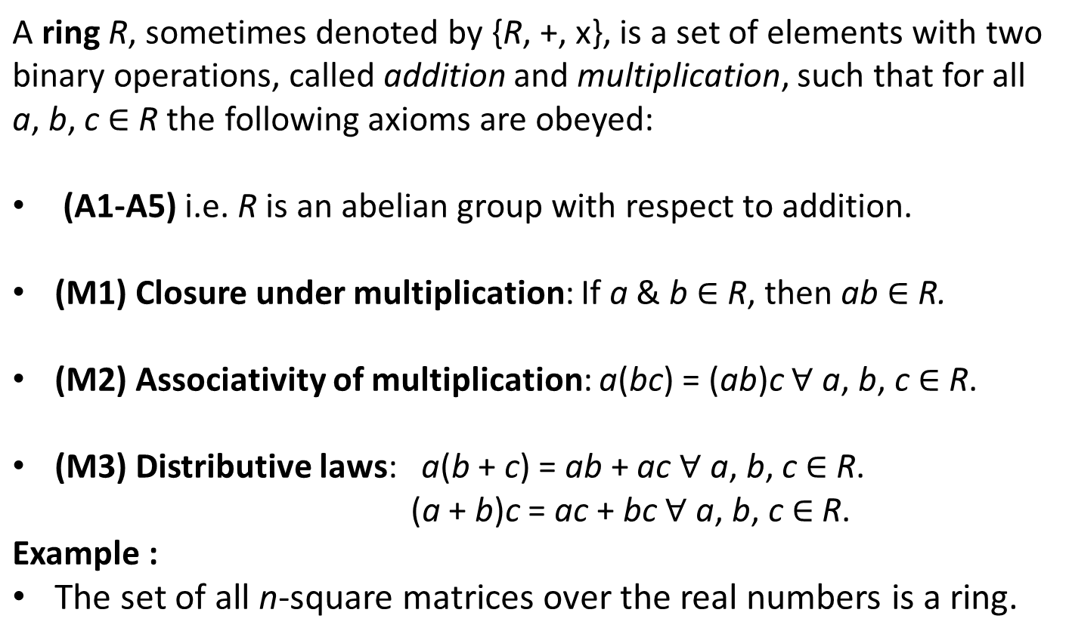

Slide 35

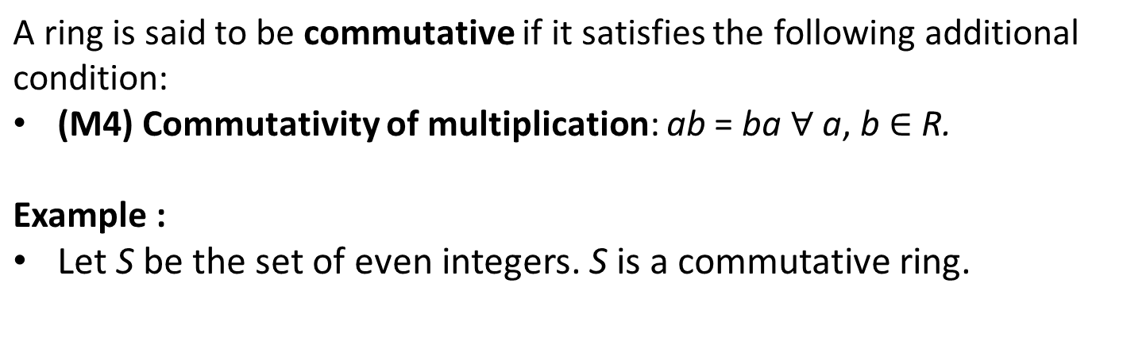

Slide 36

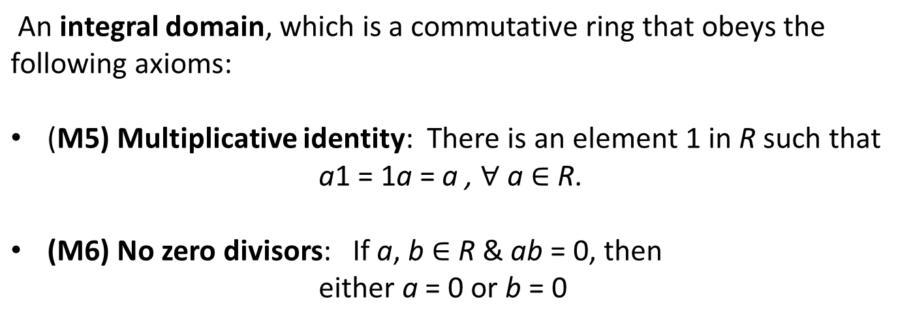
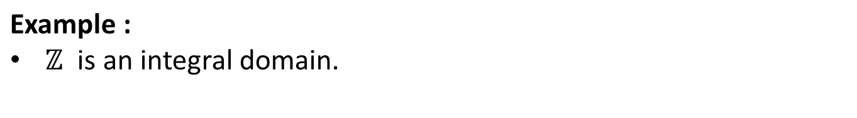

Slide 37

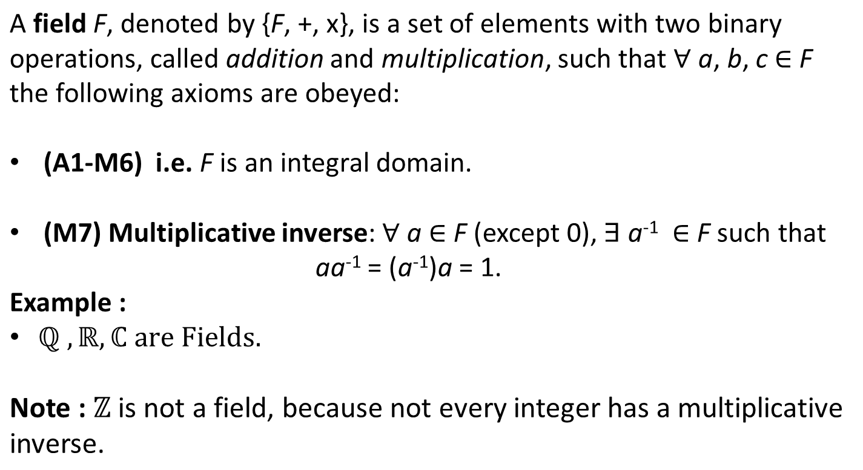

Slide 38
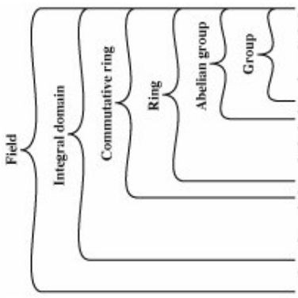
(A1) Closure Under Addition (A2) Associativity Under Addition (A3) Additive Identity
(A4) Additive Inverse
(A5) Commutative under Addition
(M1) Closure Under Multiplication (M2) Associativity Under Multiplication (M3) Distributive Laws
(M4) Commutativity of Multiplication
(M5) Multiplicative Identity (M6) No Zero Division
(M7) Multiplicative Inverse

Slide 39
Arithemtic on polynomials

Slide 40
Ordinary Polynomial Arithmetic TYPE 1

Slide 41
TYPE 1

Slide 42
TYPE 1

Slide 43
TYPE 1
TYPE 2
(RING)
TYPE 3
(FIELD)

Slide 44
TYPE 2
Polynomials are over GF(p) i.e the coefficients are within the range GF(P)
The polynomial operations are performed as TYPE 1 polynomial operations along with the coefficient operations are performed based on modular arithmetic
This set with the above addition and multiplication operations forms a ring

Slide 45
TYPE 2

Slide 46
TYPE 2
TYPE 2

Slide 47
GCD and inverse on TYPE 2 polynomials

Slide 48
DIVISIBILITY

Slide 49
DIVISION THEOREM

Slide 52
Unique Factorization Theorem

Slide 55
TYPE 3 Polynomials
(GF(p^n))

Slide 56
TYPE 3 Polynomials
A set of all polynomials whose coefficient belongs to GF(p) and the degree is lesser than n i.e remainders of a particular irreducible polynomial of degree n and coefficient belongs to GF(p)(TYPE 2 polynomial)
2. Number of elements in this set is p^n when p and n is given
3. This set forms a field

Slide 57
Generating elements in TYPE 3 set
1 TWO ways to generate the set
(i) Enumeration
(ii) using irreducible polynomial
2.First with given p and n simply enumerating all possible combination of p and n
Example
P=2(coefficient) and n=3 (degree)
Then number of elements are 2^3; 8 elements
{0, 1, X, X+1, X^2, X^2+1, X^2+X, X^2+X+1}

Slide 58

●
●

Slide 59

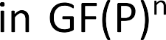







Slide 60

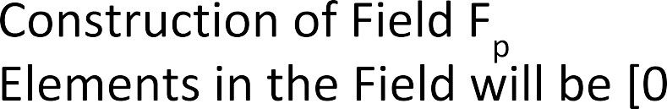
●
…
●
●
●
…

Slide 61


Slide 62
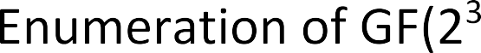


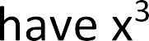


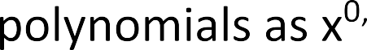
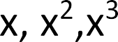
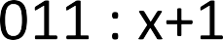
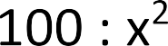





…

Slide 63



m((x)=x^{n}+x+1 ε F_{p}[x]
Where f(x) and g(x) belongs to GF(p^n)

Slide 64
TWO REPRESENTATION of GF(2^n)
Polynomial representation
Binary representation
GF(2³)={0,1,x,x+1, x^2,x^2+1,x^2+x,x^2+x+1}
GF(2³)={000,001,010,011,100,101,110,111}

Slide 67
FAST multiplication

Slide 71



Slide 72

…

